Slide 1
Models in Web API

Slide 2
Objectives
Model in ASP.NET Core MVC
APIs and Data Access
Code-first development with API
Data Transfer Objects

Slide 3
What is a Model in ASP.NET Core MVC?
A model is a class with .cs (for C#) as an extension having both properties and methods. Models are used to set or get the data.
If your application does not have data, then there is no need for a model. If your application has data, then you need a model.
The Role of Models in ASP.NET Core MVC
The Models in ASP.NET Core MVC contains a set of classes that are used to represent the domain data (you can also say the business data) as well as it also contains logic to manage the domain/business data.
Models are responsible for the data and these data are used on Views.

Slide 4
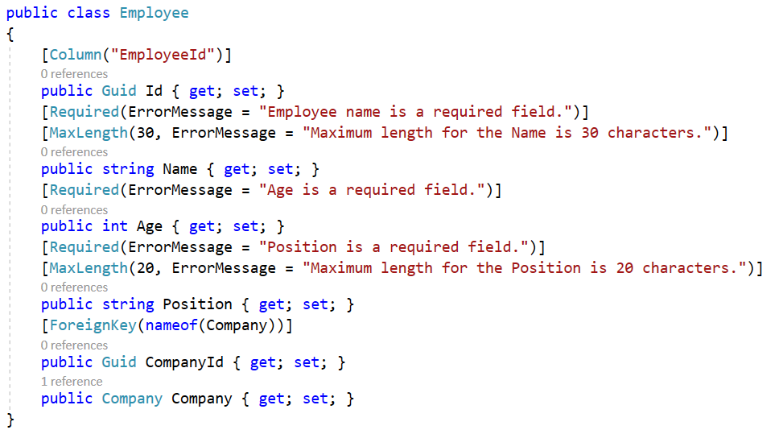
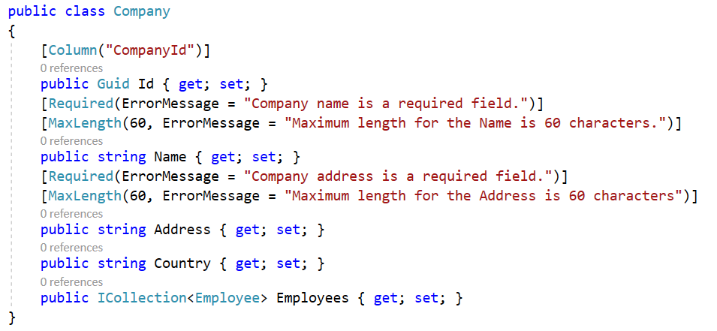
Model in ASP.NET Core MVC
The model classes represents domain-specific data and business logic in the MVC application. It represents the shape of the data as public properties and business logic as methods.

Slide 5
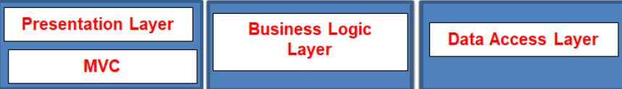
3-Layer Application
In general, a real-time application may consist of the following layers
Presentation Layer: This layer is responsible for interacting with the user.
Business Layer: This layer is responsible for implementing the core business logic of the application.
Data Access Layer: This layer is responsible for interacting with the database to perform the CRUD operations.
The MVC design pattern is basically used to implement the Presentation Layer of the application. Please have a look at the following diagram.

Slide 6
APIs and Data Access
ORM (Object Relational Mapping) and Entity Framework Core
Reviewing the different design workflows supported by EF Core
Working with database-first and code-first development and migrations
Building Web APIs that implement the most commonly used HTTP methods for serving data

Slide 7
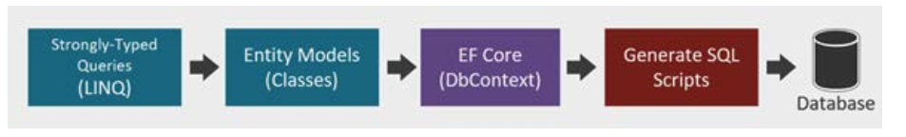
ORM and Entity Framework Core
Entity Framework Core is an ORM and a data access technology that enables C# developers to interact with a database without having to manually write SQL scripts.
ORMs like EF Core help you build data-driven applications quickly by working through .NET objects instead of interacting directly with the database schema. These .NET objects are simply classes, which are typically referred to as Entities.
With EF Core, C# developers can take advantage of their existing skills and leverage the power of Language Integrated Query (LINQ) to manipulate the dataset against the conceptual Entity Models, otherwise simply referred to as Models.

Slide 8
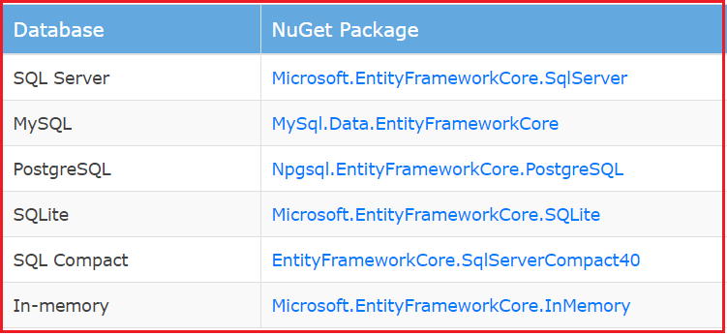
ORM and Entity Framework Core - 2
Reasons to use EF Core
Simple to get started
It supports NoSQL Databases along with relational databases
It fits nicely in ASP.NET MVC Core setup
Integrates well with LINQ
Possible to use on Linux and Mac since it is based on .NET Core along with Windows.

Slide 9
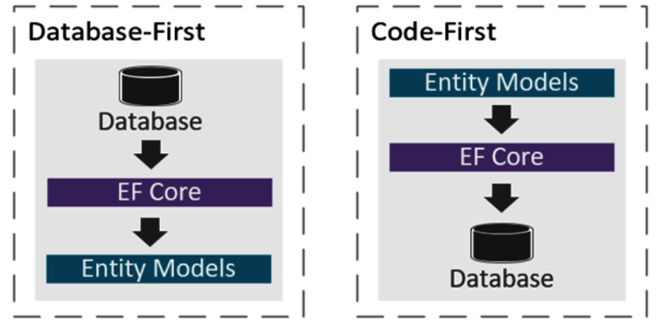
EF Core design workflows - 1

Slide 10
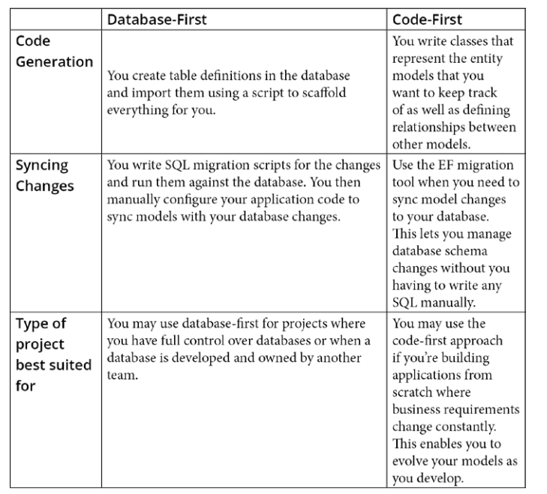
EF Core design workflows - 2
The differences between the design workflows when to apply them to the projects.

Slide 11
Generating models from an existing DB - 1
Integrating Entity Framework Core using these packages
Microsoft.EntityFrameworkCore.Tools
Microsoft.EntityFrameworkCore.SqlServer
Microsoft.EntityFrameworkCore.SqlServer.Design
Using the Scaffold-DbContext command
Scaffold-DbContext “CONNECTION STRING” Microsoft.EntityFrameworkCore.SqlServer -o Db
dotnet ef dbcontext scaffold “CONNECTION STRING HERE” Microsoft.EntityFrameworkCore.SqlServer -o Db

Slide 12
Generating models from an existing DB - 2
Connection string: The first parameter is the connection string that instructs how to connect to the database.
Provider: The database provider that will be used to execute the connection string against. In this case, we’ve used Microsoft.EntityFrameworkCore. SqlServer as the provider.
Output directory: The -o option is shorthand for –OutputDir, which enables you to specifythe location of the files to be generated. In this case, we’ve set it to Db.

Slide 13
Learning code-first development with API
Step 1. Creating a Web API project
Step 2. Configuring data access
Step 3. Managing database migrations
Step 4. Data Transfer Objects (DTOs)
Step 5. Creating Web API endpoints

Slide 14
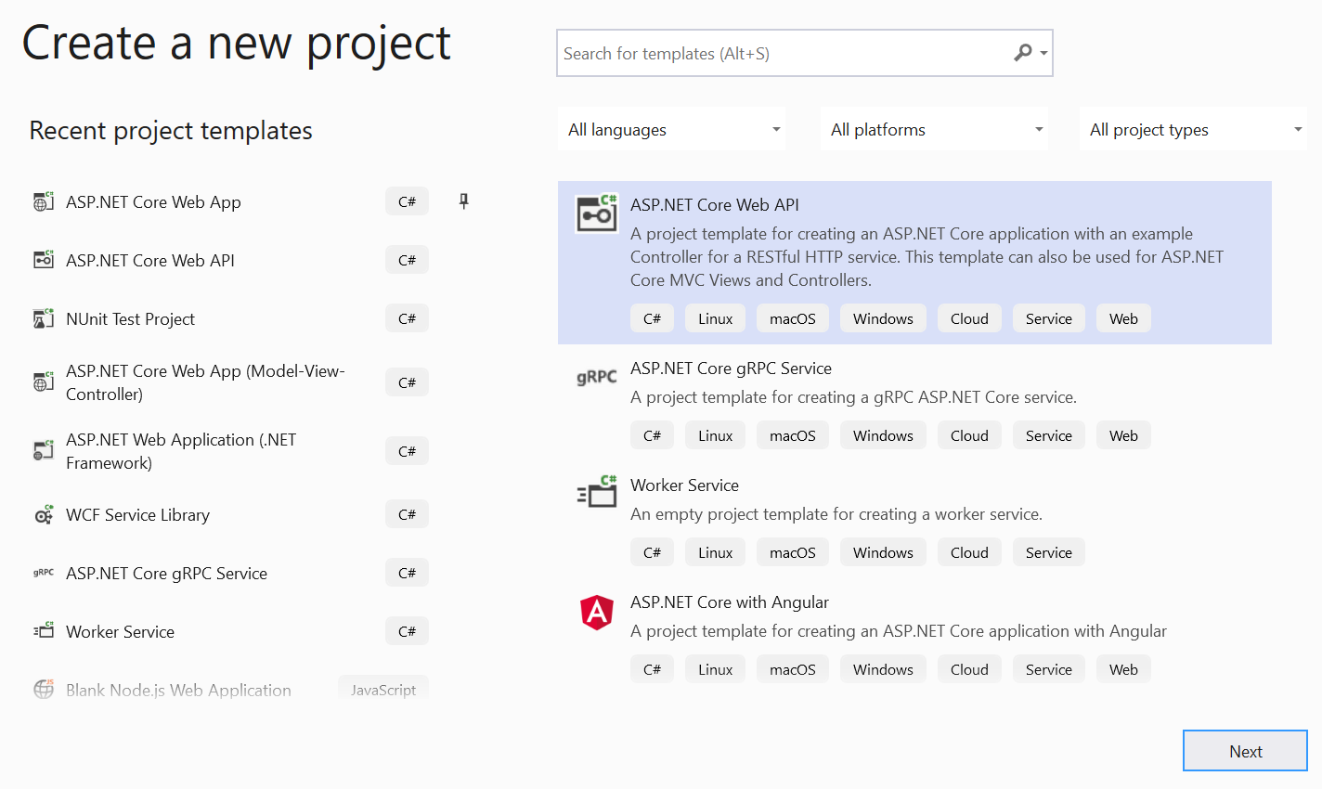
Creating a Web API project
Choose ASP.NET Core Web API project

Slide 15
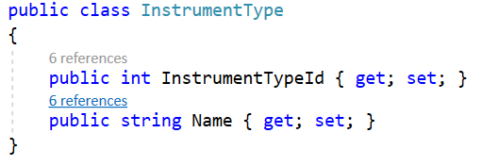
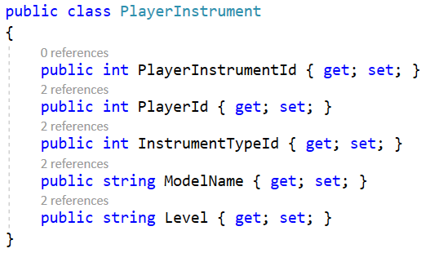
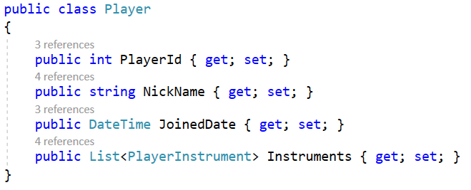
Configuring data access - 1
Install the NuGet packages:
Microsoft.EntityFrameworkCore
Microsoft.EntityFrameworkCore.Design
Microsoft.EntityFrameworkCore.SqlServer
Creating entity models

Slide 16
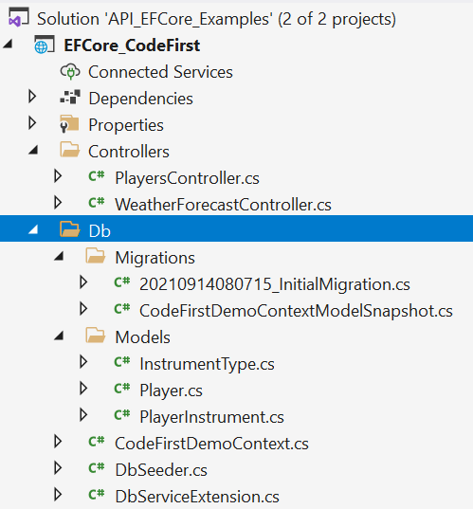
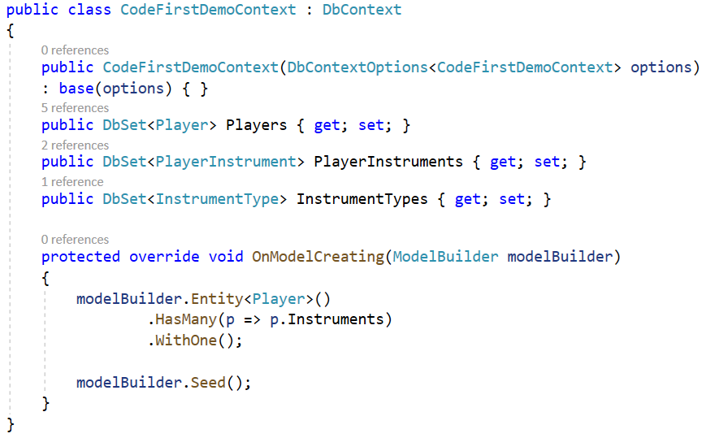
Configuring data access - 2
Defining a DbContext

Slide 17
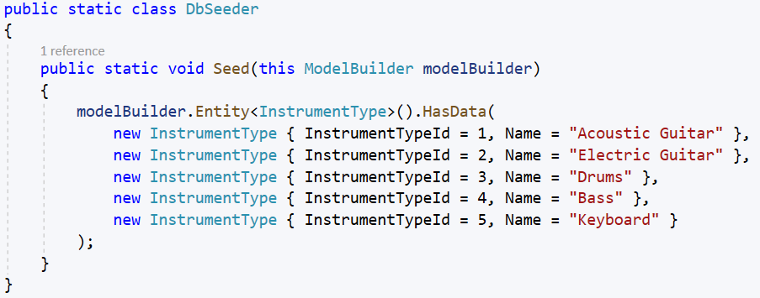
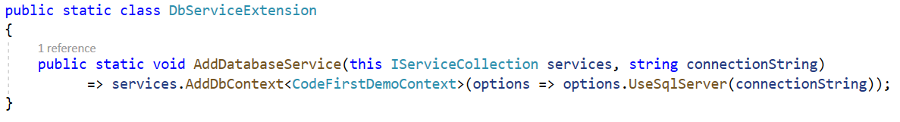
Configuring data access - 3
Seed data
Registering the DbContext as a service

Slide 18
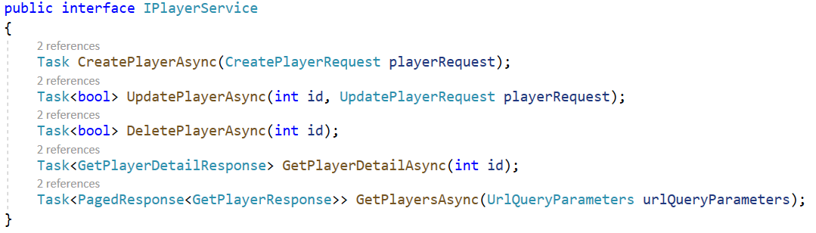
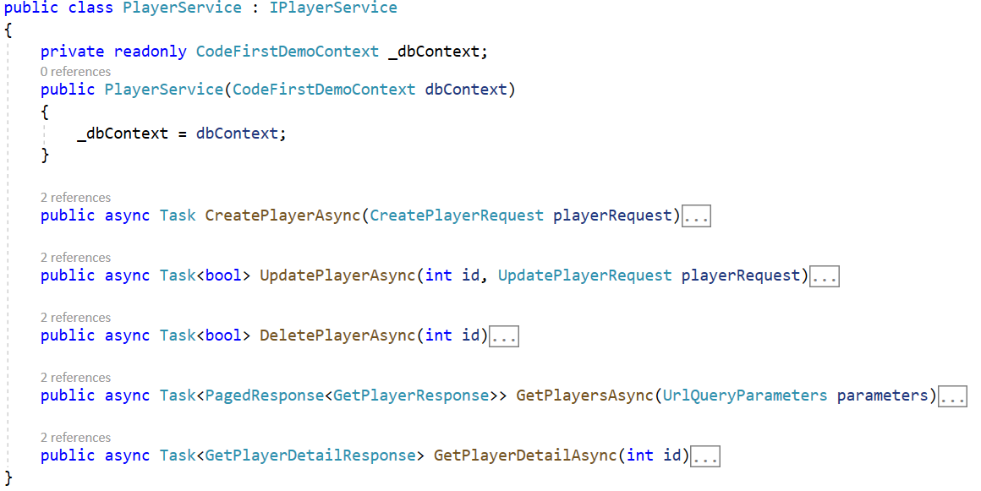
Configuring data access - 4
Create service

Slide 19
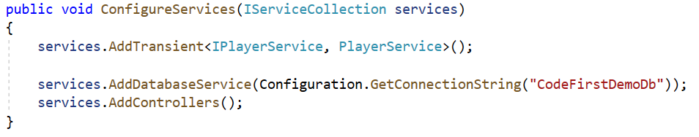
Configuring data access - 5
Setting the database ConnectionString
Modifying the Startup class
Migration
Add-Migration InitialMigration -o Db/Migrations
Update-Database -verbose

Slide 20
Data Transfer Objects (DTOs) - 1
Data Transfer Objects (DTOs) are classes that define a Model with sometimes predefined validation in place for HTTP responses and requests.
You can think of DTOs as ViewModels in MVC where you only want to expose relevant data to the View.
The basic idea of having DTOs is to decouple them from the actual Entity Model classes that are used by the data access layer to populate the data.
This way, when a requirement changes or if your Entity Model properties are changed, they won’t be affected and won’t break your API. Your Entity Model classes should only be used for database related processes.

Slide 21
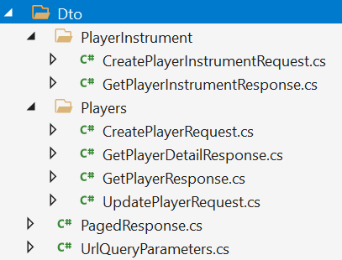
Data Transfer Objects (DTOs) - 2
Your DTOs should only be used for taking requests input and response output, and should only expose properties that you want your client to see.

Slide 22
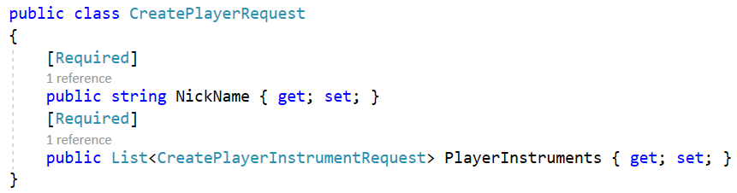
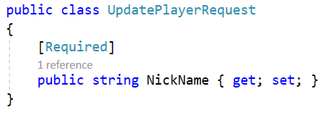
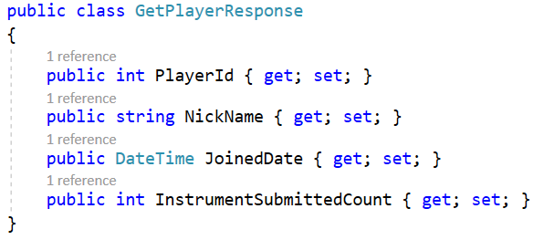
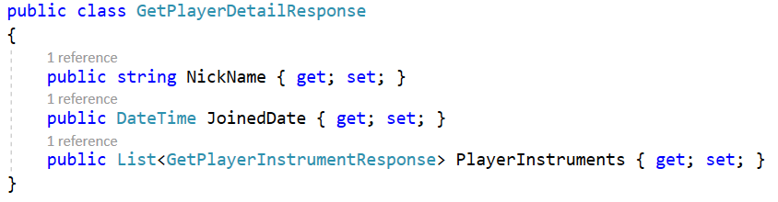
Data Transfer Objects (DTOs) - 3
DTO classes for the Models

Slide 23
Auto mapping between DTOs and entities
It's common to map a similar object to another object. It's also tedious and repetitive since generally both objects (classes) may have the same/similar properties mapped to each other.
We can use a library to automatically handle our mappings. AutoMapper is one of the best libraries for object to object mapping.
AutoMapper is an object-object mapper. Object-object mapping works by transforming an input object of one type into an output object of a different type.
Mapping can occur in many places in an application, but mostly in the boundaries between layers, such as between the UI/Domain layers, or Service/Domain layers.
Notes:
https://automapper.org/

Slide 24
Creating Web API endpoints - 1
Implementing an HTTP POST endpoint
Implementing the service
Registering the service
Testing the POST endpoint

Slide 25
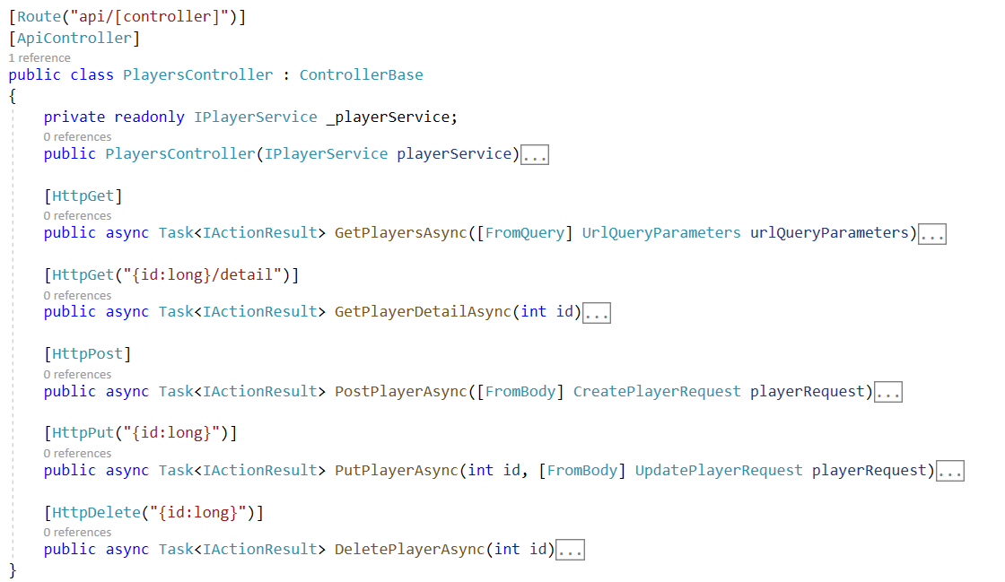
Creating Web API endpoints
Creating the API controller

Slide 26
Summary
The concepts and the different design workflows for implementing Entity Framework Core as your data access mechanism.
Understanding how the database-first and code-first workflows work is very important when deciding how you want to design your data access layer.
Learn how to create APIs that deal with a real database from scratch gives you a better understanding of how the underlying backend application works, especially if you will be working with real applications that use the same technology stack.
Design an API to make it more testable and maintainable by leveraging interface abstraction, and learned about the concepts of having DTOs to value the separation of concerns and how to make API controllers as thin as possible.

